Slide 1


Cellula technolgis
Cellula technolgis
Cellula technolgis
EDA
TAXI
TRAVEL DATASET

Slide 2

Cellula technolgis
Table of
CONTENTS
01
02
03
04
Intro
Data cleaning
Data analysis
conclusion

Slide 3

INTRODUCTION
A customer named Farid wants a ride from home to work and uses the Wasalny application.
The goal is to predict the fare amount for the ride using the Wasalny application.
The task is to analyze customer data and clean unnecessary values or columns to ensure accurate predictions.

Slide 4

what is Data cleaning ?
what we did in our data ?
what could be improved in the next time?
Data cleaning

Slide 5
Data Analysis

Slide 6
Cellula technolgis
Cellula technolgis
Cellula technolgis
PickUp & DropOff
Locations

Slide 7
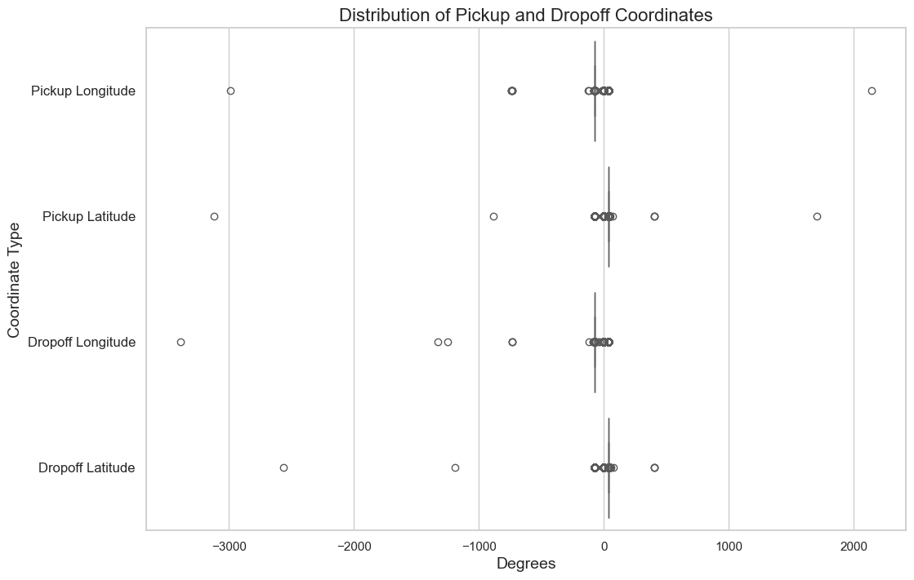


Slide 8
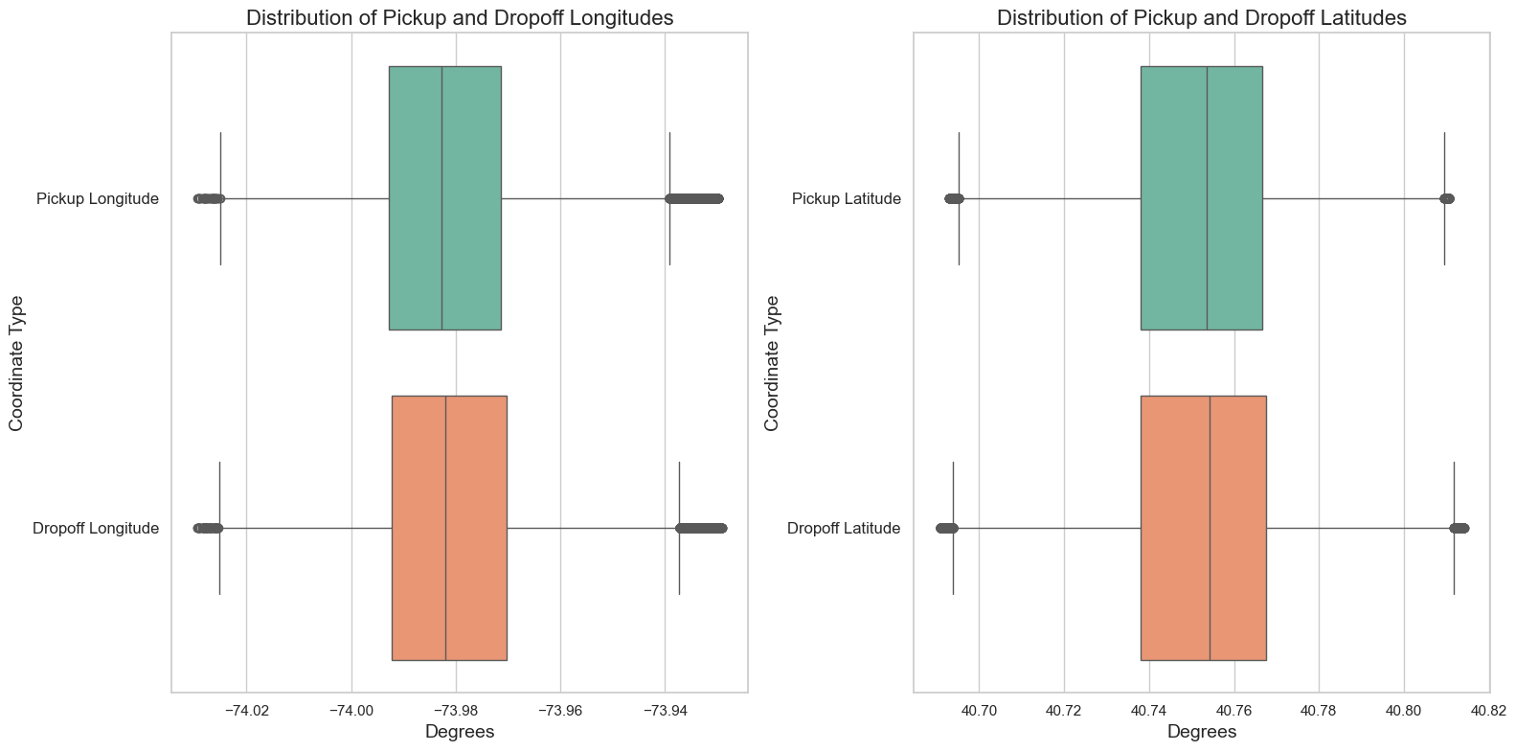

Slide 9
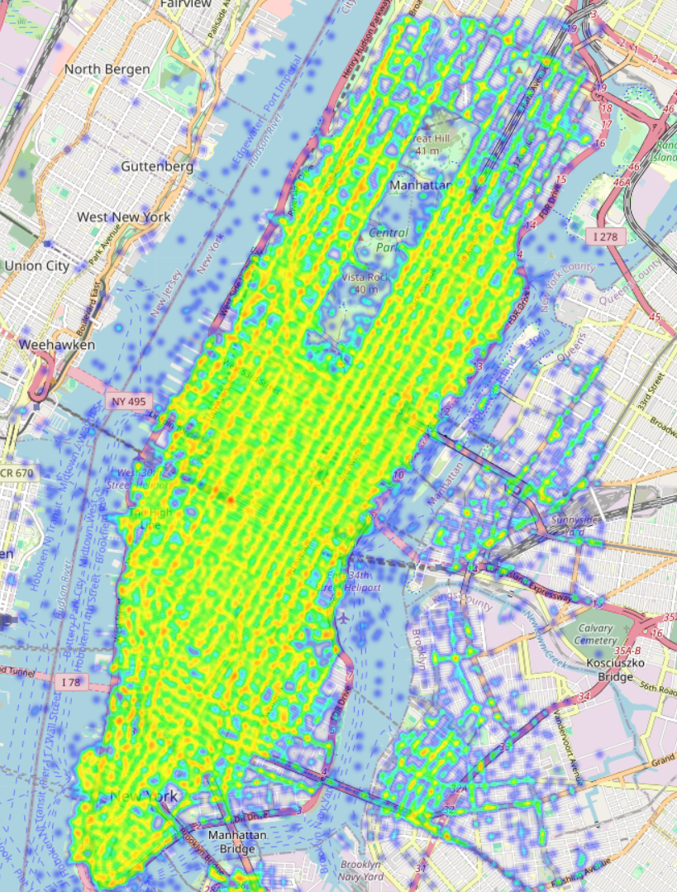
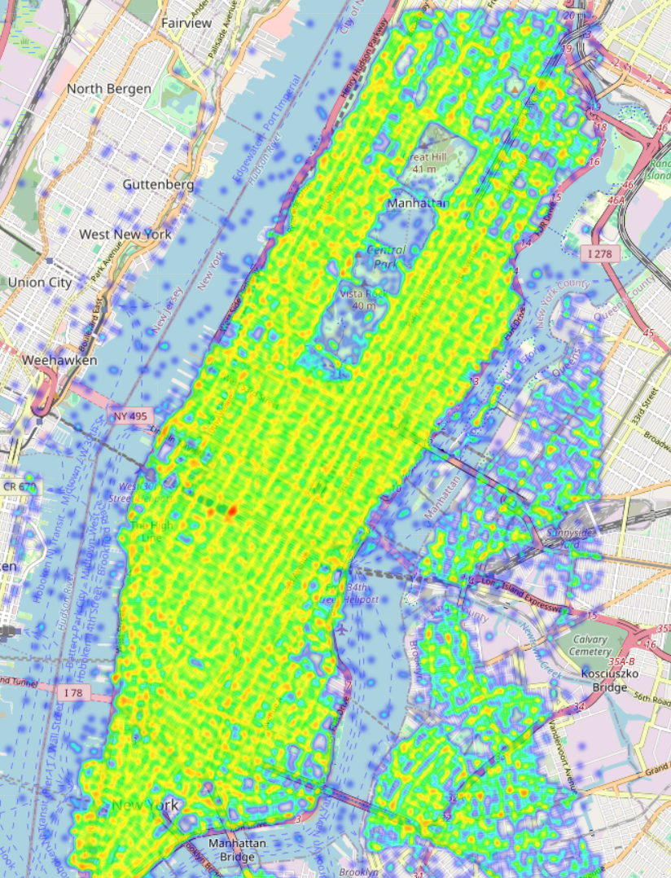
PickUp Heatmap
DropOff Heatmap

Slide 10
Cellula technolgis
Cellula technolgis
Cellula technolgis
Bearing

Slide 11
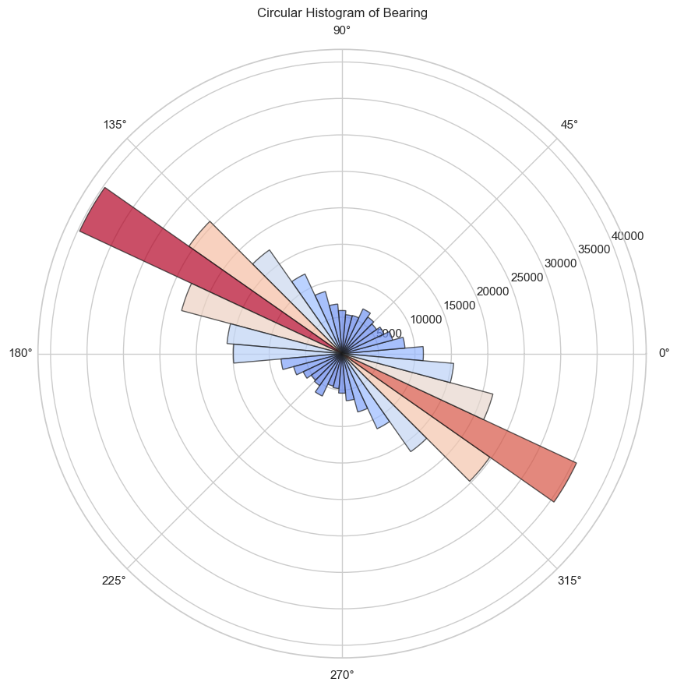

Slide 12

Proposed
conclusion
SOLUTIONS
The taxi app data shows that ride details and fares vary a lot based on the time of day, location, and traffic. We found some issues like inconsistent data, outliers, and missing values.
Create New Features: Include important details like weather and traffic information.
Build Prediction Models: Use machine learning to predict fares accurately.
Improve User Experience: Provide fare estimates and use dynamic pricing.
Monitor and Improve: Regularly update the models and gather user feedback to keep improving.

Slide 13
Meet
THE TEAM
Toka Abdelghfar
Hussien Negm
Sayed Gamal
Samer Magdy Makram
Osama Almomani
Ahmed El Qaisi
Hossam Ali

Slide 14
Cellula technolgis
THANK YOU!

